Slide 1
ICMS University
BCS 5th
Software Engineering
Lecture 5

Slide 2
The bedrock that supports software engineering is a quality focus. The foundation for software engineering is the process layer. – Process defines a framework for a set of key process areas (KPAs) that must be established for effective delivery of software engineering technology.

Slide 3
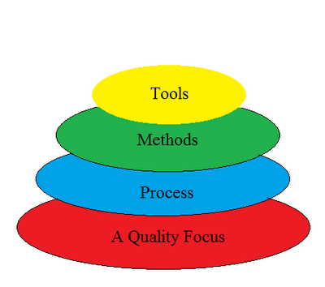
Divided into 4 layers
Layer

Slide 4
Divided into 4 layers:-
1. A quality Process :-
Any engineering approach must rest on an quality.
The "Bed Rock" that supports software Engineering is Quality Focus.
2. Process :-
Foundation for SE is the Process Layer
SE process is the GLUE that holds all the technology layers together and enables the timely development of computer software.
It forms the base for management control of software project.

Slide 5
Divided into 4 layers:-
3. Methods :-
SE methods provide the "Technical Questions" for building Software.
Methods contain a broad array of tasks that include communication requirement analysis, design modeling, program construction testing and support.

Slide 6
Divided into 4 layers:-
4. Tools :-
SE tools provide automated or semi-automated support for the "Process" and the "Methods".
Tools are integrated so that information created by one tool can be used by another.

Slide 7
Outline
What is software process
What does a software process model description include
2 major types of software processes: plan-driven and agile process
3 process models: water-fall, incremental, reuse

Slide 8
The software process
Software process: organizing a structured set of activities to develop software systems.
Many different software processes but all involve the following activities:
  Specification – defining what the system should do;
  Design and implementation – defining the organization of the system and implementing the system;
  Validation – checking that it does what the customer wants;
  Evolution – changing the system in response to changing customer needs.
Chapter 2 Software Processes

Slide 9
Outline
What is software process
What does a software process model description include
2 major types of software processes: plan-driven and agile process
3 process models

Slide 10
Software Process Model descriptions
A software process model is an abstract representation of a process. It presents a description of a process.
When we describe and discuss processes, we usually talk about the activities in these processes such as specifying a data model, designing a user interface, etc. and the ordering of these activities.
Process descriptions may also include:
  Products, which are the outcomes of a process activity;
  Roles, which reflect the responsibilities of the people involved in the process;
  Pre- and post-conditions, which are statements that are true before and after a process activity has been enacted or a product produced.
Notation: activities, products
Chapter 2 Software Processes

Slide 11
Outline
What is software process
What does a software process model description include
2 major types of software processes: plan-driven and agile process
3 process models

Slide 12
Plan-driven and agile processes
Plan-driven processes are processes where all of the process activities are planned in advance and progress is measured against this plan.
In agile processes, planning is incremental and it is easier to change the process to reflect changing customer requirements.
In practice, most practical processes include elements of both plan-driven and agile approaches.
There are no right or wrong software processes.
Chapter 2 Software Processes

Slide 13
Outline
What is software process
What does a software process model description include
2 major types of software processes: plan-driven and agile process
3 process models

Slide 14
Software process models
The waterfall model
  Plan-driven model. Separate and distinct phases of specification and development.
Incremental development
  Specification, development and validation are interleaved. May be plan-driven or agile.
Reuse-oriented software engineering
  The system is assembled from existing components. May be plan-driven or agile.
In practice, most large systems are developed using a process that incorporates elements from all of these models.
Chapter 2 Software Processes

Slide 15
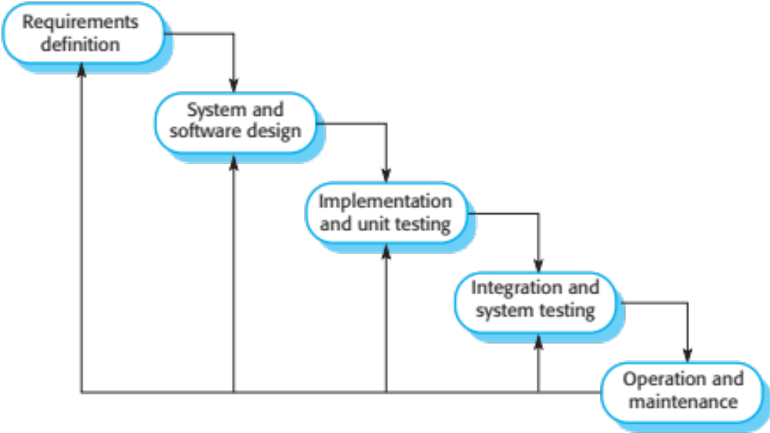
The waterfall model
Chapter 2 Software Processes

Slide 16
Waterfall model phases
There are separate identified phases in the waterfall model:
  Requirements analysis and definition
  System and software design
  Implementation and unit testing
  Integration and system testing
  Operation and maintenance
The main drawback of the waterfall model is the difficulty of accommodating change after the process is underway. In principle, a phase has to be complete before moving onto the next phase.
Chapter 2 Software Processes

Slide 17
Waterfall model problems
Inflexible partitioning of the project into distinct stages makes it difficult to respond to changing customer requirements.
  Therefore, this model is only appropriate when the requirements are well-understood and changes will be fairly limited during the design process.
  Few business systems have stable requirements.
The waterfall model is mostly used for large systems engineering projects where a system is developed at several sites.
  In those circumstances, the plan-driven nature of the waterfall model helps coordinate the work.
Chapter 2 Software Processes

Slide 18
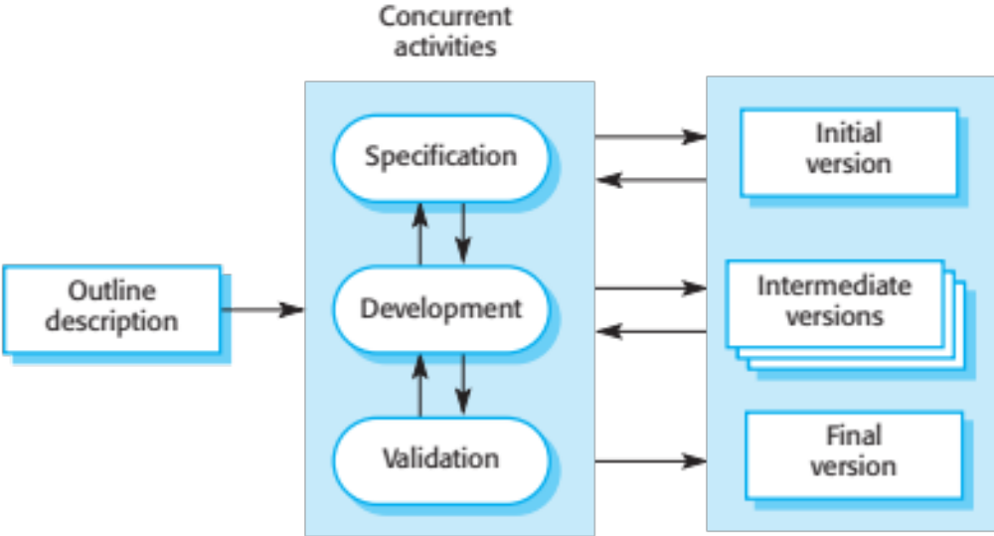
Incremental development
Chapter 2 Software Processes

Slide 19
Incremental development benefits
The cost of accommodating changing customer requirements is reduced.
  The amount of analysis and documentation that has to be redone is much less than is required with the waterfall model.
It is easier to get customer feedback on the development work that has been done.
  Customers can comment on demonstrations of the software and see how much has been implemented.
More rapid delivery and deployment of useful software to the customer is possible.
  Customers are able to use and gain value from the software earlier than is possible with a waterfall process.
Chapter 2 Software Processes

Slide 20
Incremental development problems
The process is not visible.
  Managers need regular deliverables to measure progress. If systems are developed quickly, it is not cost-effective to produce documents that reflect every version of the system.
System structure tends to degrade as new increments are added.
  Unless time and money is spent on refactoring to improve the software, regular change tends to corrupt its structure. Incorporating further software changes becomes increasingly difficult and costly.
Chapter 2 Software Processes

Slide 21
Reuse-oriented software engineering
Based on systematic reuse where systems are integrated from existing components or COTS (Commercial-off-the-shelf) systems.
Process stages
  Component analysis;
  Requirements modification;
  System design with reuse;
  Development and integration.
Reuse is now the standard approach for building many types of business system
  Reuse covered in more depth in Chapter 16.
Chapter 2 Software Processes

Slide 22
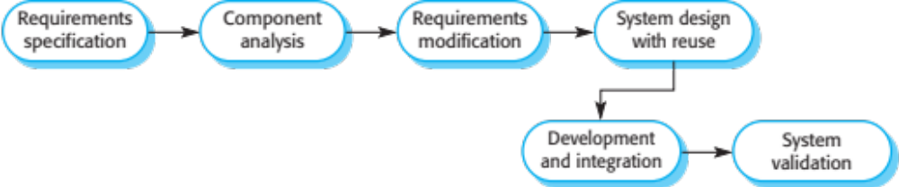
Reuse-oriented software engineering
Chapter 2 Software Processes

Slide 23
Types of software component
Web services that are developed according to service standards and which are available for remote invocation.
Collections of objects that are developed as a package to be integrated with a component framework such as .NET or J2EE.
Stand-alone software systems (COTS) that are configured for use in a particular environment.
Chapter 2 Software Processes

Slide 24
Serial or Linear Sequential Development Model
This Model also called as the Classic life cycle or the Waterfall model. The Linear sequential model suggests a systematic sequential approach to software development that begins at the system level and progresses through analysis, design, coding, testing, and support. The linear sequential model has the following activities;

Slide 25
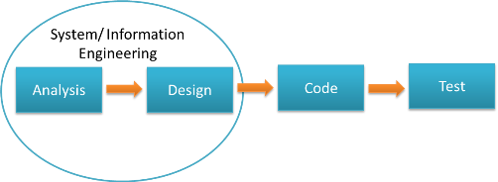
Serial or Linear Sequential Development Model
Model

Slide 26
Prototyping model
A prototying model requires that before carrying out the development of the actual software, a working prototype of the system should be built.
➢ A prototype is a toy implementation of the system.
➢ A prototype usually turns out to be a very crude version of the actual system, possibly exhibiting limited functional capabilities, low reliability, and inefficient performance as compared to the actual software.

Slide 27


